Slide 1
Hosted Git
github

Slide 2


From an alumnus (2010)
You know, the more time I spent in industry the better I've understood what a strong advocate you are for the students in the CS program. You genuinely want to see us succeed in our careers, above all else.

Slide 3
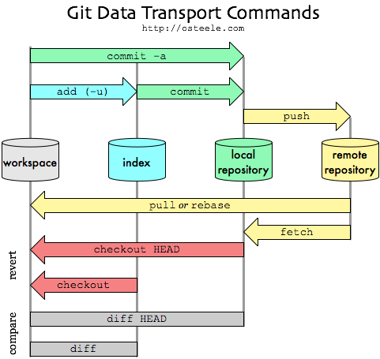
The Big Picture
Now we’ll talk about this part
http://blog.mikepearce.net/2010/05/18/the-difference-between-git-pull-git-fetch-and-git-clone-and-git-rebase/

Slide 4
GitHub
Largest open source git hosting site
Public and private options
  CS collaboration policy: your homework must be stored in a private repository.
  https://education.github.com/
User-centric rather than project-centric
Try it
  Log onto github
  Walk through the tutorials

Slide 5

How do I use github?
Set up a user account
  public account is free, students can request 5 private
  e.g. CyndiRader
  Remember your password!
Create a repository
  e.g. GitDemoCode
Add github as a “remote”
Push your master branch (later we’ll deal with other branches, just work with master for now)
Add collaborators (if public, everyone can read, but not write. If private, must be collaborator to even read)
http://git-scm.com/book/en/v2/Git-Basics-Working-with-Remotes

Slide 6
Typical workflow
Person A
Setup project & repo
push code onto github
edit/commit
edit/commit
pull/push
Person B
clone code from github
edit/commit/push
edit…
edit… commit
pull/push
This is just the flow, specific commands on following slides.
It’s also possible to create your project first on github, then clone (i.e., no git init)

Slide 7
Remote repository
Remote repository is a bare repository
There is no working directory
Four transfer protocols
  http – this is what I recommend/use
  local (not covered – good for shared filesystems)
  git (not covered – fast but more setup)
  SSH (supplementary material at end of slides, not covered)

Slide 8
Smart http
Added to git in v. 1.6.6
Read about it:
  http://git-scm.com/2010/03/04/smart-http.html
Use it on the client:
  git clone https://github.com/CyndiRader/JavaDemos.git
protocol
userID
repository
When you create a repo on github, it will show you the HTTPS clone URL
Avoid typos: a) copy the URL, b) in git bash, click git-icon/edit/paste OR press Insert.

Slide 9
Create the repo – Option 1
Log onto github
Click on + to add repository
Enter name
Add .gitignore, good to have a README
Click on Settings to control access (Collaborators tab)
On PC, do git clone

Slide 10
Create the repo – Option 2
Create your Java Project
Create your local repo
  git init
  git commit –m “Initial commit”
Create a repo on github
Add a “shortname” for your git repository
  git remote add [shortname] [url]
  git remote add origin https://github.com:[user name]/[repository name].git
  Ex: git remote add origin https://github.com:CyndiRader/JavaDemos.git
  Remember: You can copy/paste the repo url from github
Push your code onto github
  git push –u [remote-name] [branch-name].
  Ex: git push –u origin master – enter username/password

Slide 11
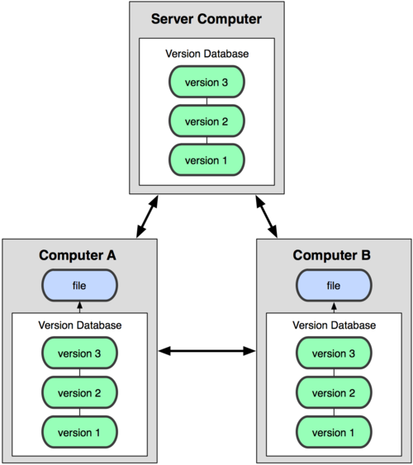
Collaborating via github - cloning
git clone adds the remote repository under the name origin
git clone https://github.com:[user name]/[repository name].git
  git clone https://github.com:CyndiRader/JavaDemos.git

Slide 12
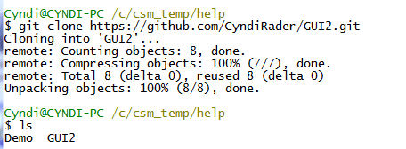
Example
Assume I have a repo named GUI2.git
In Eclipse: (from the directory where the clone was run): File -> New JavaProject -> GUI2

Slide 13
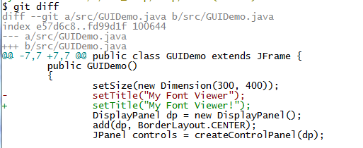
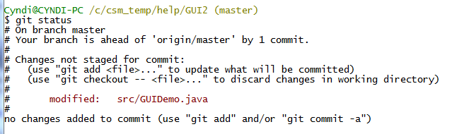
Push example
Make a change to one of the files
See status (I already made one commit)

Slide 14
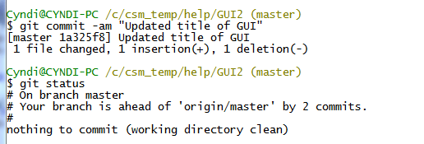
Push example continued
Commit changes – updates local repo

Slide 15
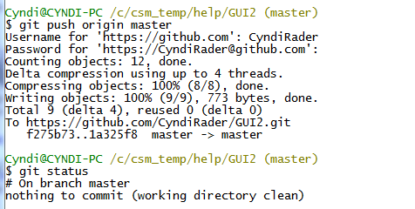
Push example, continued

Slide 16
Keep everyone in synch
Be very careful not to make conflicting changes!
Merge with conflicts covered later
Two options for synchronizing:
  Fetch/merge
  Pull
Pull is usually simpler, but we’ll cover both.

Slide 17


Fetch example - On original machine
Fetch, merge
fast-forward covered under branching

Slide 18
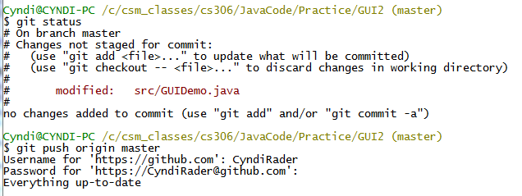
Pull example – on original machine
If you’re careful to avoid conflicts, and you’re working on the master branch, easier to just pull.
Make some changes on original machine
Don’t forget to commit! (see push below, didn’t work)

Slide 19
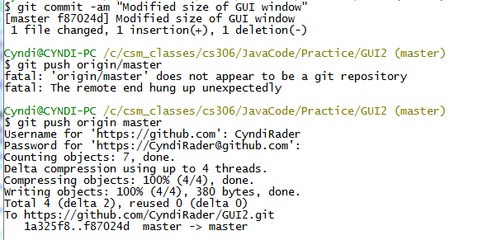
Pull continued
Note typo. git merge origin/master BUT git push origin master.
Merge is specifying the branch to merge (in this case master branch on remote named origin - branches covered in detail later).
Push is specifying the remote and the local branch.
typo

Slide 20
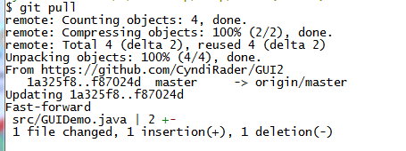
Pull continued – on clone machine
git pull origin master
git pull (assumes origin, master)

Slide 21
Supplemental

Slide 22
SSH
Used to be most common transport for git
Pros
  Allows reads and writes
  Authenticated network protocol
  Secure: data transfer is encrypted and authenticated
  Efficient: makes data as compact as possible
Cons
  No anonymous read-only access

Slide 23
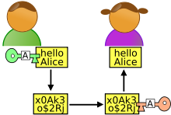
Sidebar: What is SSH?
SSH is a protocol used for secure network communication
Getting files from github
Generate public/private keys (ssh-keygen)
Distribute public keys (add key to github)
Someone (github) sends secure “message” (files) – they encode with public key
You receive the message/files – decode with private key (only you know)
Putting files on github
Process is reversed to send files to github
You have the github public key (see github_rsa.pub, in Documents and Settings/Cyndi/.ssh on my machine)
Use it to encode when sending
github uses their private key to decode

